Slide 1
Intallation and configuration of MySql
Downloading of MySql
Setting up of MySql

Slide 2
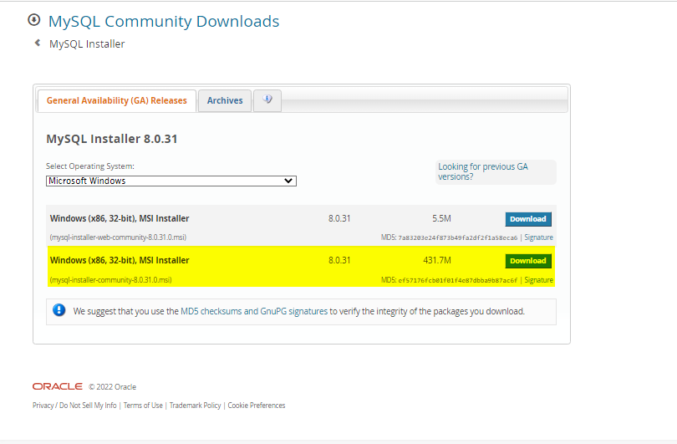
Download MySql
Link to Download SQL
https://dev.mysql.com/downloads/windows/installer/

Slide 3
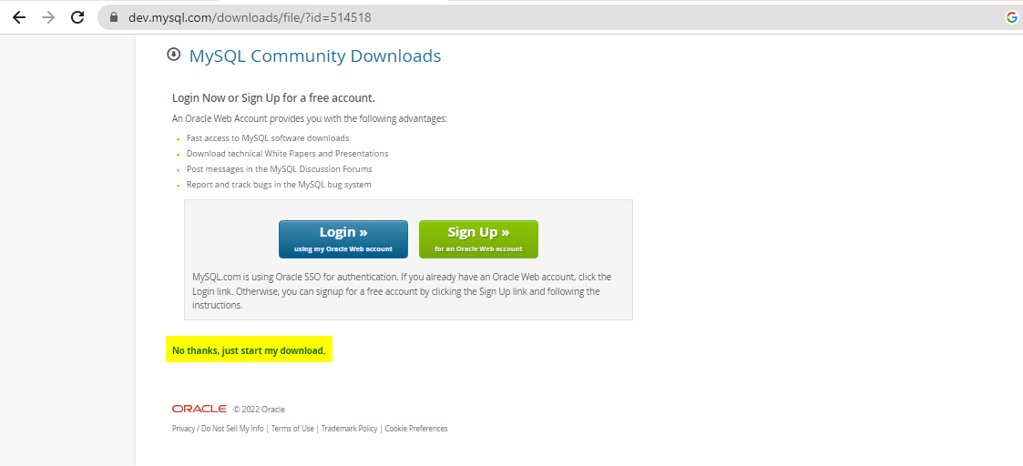

Slide 4
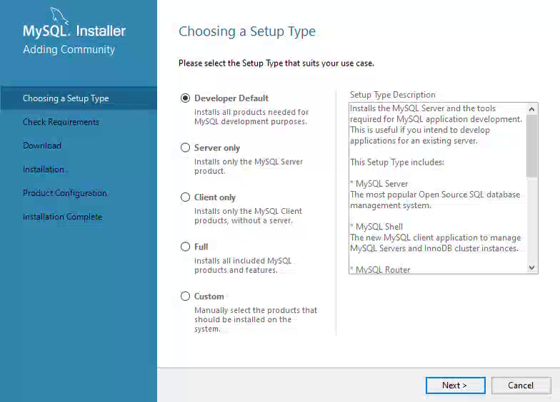
Installation of MySql
Check out the link for the installation of the MySql
https://github.com/lanceqa81/Notes/blob/main/MySql_Installation.mp4

